Slide 1
Database Management Systems Cornerstone Project
Final Review (Review II)
E-Commerce Order Management System
GUIDED BY
PRESENTED BY
MRS. V. Narasamba mam
M.Hemanth babu (25B11AI739)
G.shara (25B11AI038)
P.Sri datha sai krishna(25B11AI097)
Ch.Teja sai durga(25B11AI203)
Department of Artificial Intelligence & Machine Learning

Slide 2
Presentation Outline
Abstract
Finalize title, objectives & problem statement
Identify entities & attributes
Design ER diagram & relationships
Prepare relational database schema
Define Primary & Foreign Keys
Create GitHub repo & responsibilities
Database creation & constraints
Insert sample data
DDL, DML & DQL operations
CRUD operations & SQL queries
Data integrity & validation
Project documentation
Demonstrate & present database
Conclusion

Slide 3


DESIGN
Title: E-Commerce Order Management System
Problem Statement
Managing customers, products, orders, payments, shipping and delivery manually can lead to data inconsistency, duplication and inefficient order tracking.
Objectives
Store and manage customer and product information.
Manage orders, order items, payments and shipping.
Track order status and delivery information.
Ensure data integrity using Primary and Foreign Keys.
Provide efficient retrieval of order and sales information.

Slide 4
ENTITIES & ATTRIBUTES
ENTITY | ATTRIBUTES
CUSTOMER | Customer_ID (PK), Name, Email, Phone, Address
CATEGORY | Category_ID (PK), Category_Name, Description
PRODUCT | Product_ID (PK), Product_Name, Price, Stock_Quantity, Category_ID (FK)
ORDER | Order_ID (PK), Order_Date, Total_Amount, Order_Status, Customer_ID (FK)
ORDER_ITEM | Order_Item_ID (PK), Order_ID (FK), Product_ID (FK), Quantity, Subtotal
PAYMENT | Payment_ID (PK), Order_ID (FK), Payment_Date, Payment_Method, Payment_Status, Amount
SHIPPING | Shipping_ID (PK), Order_ID (FK), Shipping_Address, Shipping_Date, Delivery_Date, Shipping_Status

Slide 5
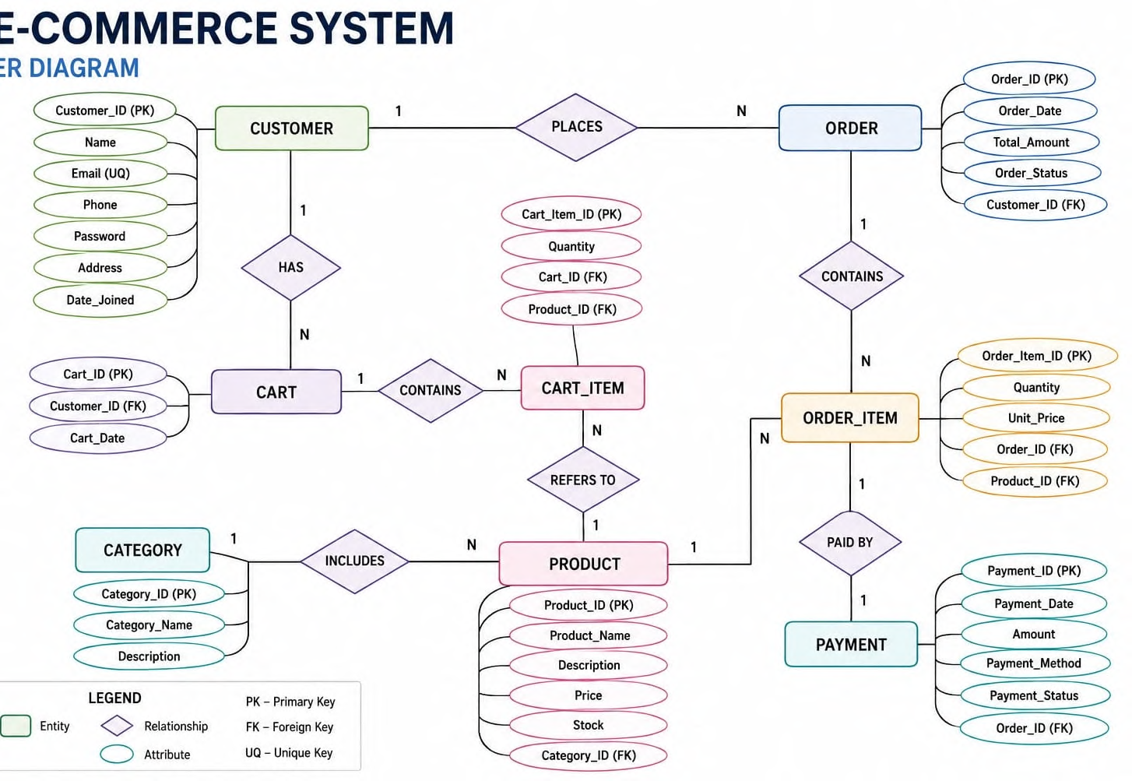
ER DIAGRAM

Slide 6
RELATIONAL DATABASE SCHEMA
CUSTOMER
Customer id PK, name, email, phone, address
CATEGORY
Category id PK, category name, description
PRODUCT
Product_id PK, product name, price, stock quantity, category id FK
ORDERS
Order id PK, order date, total amount, order status, customer id FK
ORDER_ITEM
Order item id PK, order id FK, product id FK, quantity, subtotal
PAYMENT
Payment id PK, order id FK, payment date, payment method, payment status, amount
SHIPPING
Shipping id PK, order id FK, shipping address, shipping date, delivery date, shipping status

Slide 7
PRIMARY & FOREIGN KEYS
Keys maintain uniqueness and referential integrity
PRIMARY KEY: A primary key (PK) is a column or set of columns that uniquely identifies each record in the table. It cannot contain duplicate or NULL values.
FOREIGN KEY: A foreign key (FK) is a column that creates a connection between two tables; it refers to the primary key of another table.
Primary Keys (PK)
Foreign Keys (FK)
CUSTOMER: Customer_ID
CATEGORY: Category_ID
PRODUCT: Product_ID
ORDERS: Order_ID
ORDER_ITEM: Order_Item_ID
PAYMENT: Payment_ID
SHIPPING: Shipping_ID
PRODUCT.Category_ID → CATEGORY.Category_ID
ORDERS.Customer_ID → CUSTOMER.Customer_ID
ORDER_ITEM.Order_ID → ORDERS.Order_ID
ORDER_ITEM.Product_ID → PRODUCT.Product_ID
PAYMENT.Order_ID → ORDERS.Order_ID
SHIPPING.Order_ID → ORDERS.Order_ID

Slide 8
GITHUB REPOSITORY & TEAM
Repository: github.com/<team>/ecommerce-order-management
Structure: /schema, /queries, /sample-data, /docs, README.md
GH
Team Responsibilities:
Member 1: ER diagram & relational schema design
Member 2: Table creation, keys & constraints
Member 3: Sample data & CRUD / SQL queries
Member 4: Testing, documentation & presentation
Repository
ecommerce-order-management-system

Slide 9
DATABASE & CONSTRAINTS
Database created and tables defined with integrity constraints:
NOT NULL — name, email, price, order_date must be present.
UNIQUE — Customer.email, Shipment.tracking_no.
CHECK — price > 0, stock_qty >= 0, quantity > 0.
DEFAULT — Order.status = 'Pending', Payment.status = 'Unpaid'.
PRIMARY / FOREIGN KEY — enforce identity & referential integrity.
Example
CREATE TABLE Orders (
order_id INT PRIMARY KEY,
status VARCHAR(20) DEFAULT 'Pending',
total_amount DECIMAL CHECK (total_amount >= 0)
);

Slide 10
SAMPLE DATA INSERTION
Table | Rows | Sample Record
Customer | 25 | C001, Ravi Kumar, ravi@mail.com
Product | 40 | P010, Wireless Mouse, ₹599, stock 120
Order | 60 | O100, C001, 2026-02-11, Shipped
Order_Item | 150 | I200, O100, P010, qty 2
Payment | 60 | PAY55, O100, UPI, ₹1198
Shipment | 60 | SH88, O100, BlueDart, In Transit

Slide 11
DDL, DML & DQL OPERATIONS
01
02
03
DDL (structure)
DML (data)
DQL (retrieval)
CREATE, ALTER, DROP & TRUNCATE to define and modify table structures.
INSERT, UPDATE & DELETE to manage records within the tables.
SELECT with WHERE, ORDER BY & GROUP BY to retrieve data.
CREATE TABLE Orders (...);
ALTER TABLE Product ADD COLUMN brand VARCHAR(50);
TRUNCATE / DROP for resetting tables.
INSERT INTO Customer ...;
UPDATE Product SET stock_qty = stock_qty - 1 WHERE product_id = 101;
DELETE FROM Order WHERE status = 'Cancelled';
SELECT * FROM Orders WHERE status = 'Delivered';
SELECT name, price FROM Product ORDER BY price DESC;

Slide 12
CRUD & SQL QUERIES
01
02
03
04
Create
Read
Update
Delete
Add new orders, customers & products into the database.
Joins, aggregate functions & views for sales reports.
Modify order status, stock levels & customer details.
Remove cancelled orders while preserving integrity.
CRUD: Create order, Read order status, Update stock/status, Delete cancelled orders.
Joins:
SELECT o.order_id, c.name, p.name, oi.quantity FROM Orders o JOIN Customer c ON o.customer_id=c.customer_id JOIN Order_Item oi ON o.order_id=oi.order_id JOIN Product p ON oi.product_id=p.product_id;
Aggregate:
SELECT customer_id, SUM(total_amount) AS spend FROM Orders GROUP BY customer_id HAVING SUM(total_amount) > 5000;
View:
CREATE VIEW Sales_Summary AS SELECT p.name, SUM(oi.quantity) AS units_sold FROM Order_Item oi JOIN Product p ON oi.product_id=p.product_id GROUP BY p.name;

Slide 13
DATA INTEGRITY & VALIDATION
01
02
03
No Duplicates
Valid Data
Referential
Primary keys & unique constraints prevent duplicate IDs.
Check constraints ensure only valid prices, quantities & emails.
Foreign keys keep orders linked to valid customers & products.
Data integrity is maintained through:
Entity integrity — PRIMARY KEYs prevent duplicate/NULL IDs.
Referential integrity — FOREIGN KEYs block orphan orders/items.
Domain integrity — CHECK & data types keep valid values (price > 0).
UNIQUE — no repeated emails or tracking numbers.
Validation — stock can't go negative; quantity must be positive.
ON DELETE CASCADE / RESTRICT rules preserve consistency across related tables.

Slide 14






PROJECT DOCUMENTATION
Complete project documentation includes:
ER Diagram
Relational Schema
Entities, attributes & relationships.
Tables with keys & constraints.
Data Dictionary
SQL Queries
Attribute names, types & descriptions.
DDL, DML, DQL, joins, views.
Screenshots
README
Table outputs & query results.
Setup steps & team contributions on GitHub.

Slide 15

DEMONSTRATE & PRESENT
Live demonstration of the working database:
Place a new order & auto-update product stock.
Process payment and change order status.
Track shipment and mark as delivered.
Run join, aggregate & view queries for reports.
Show constraint enforcement & error handling.
The presentation walks through design decisions, live SQL execution, and query outputs proving end-to-end order management.

Slide 16
CONCLUSION
Summary: A normalized relational database was designed and implemented to manage the full e-commerce order lifecycle — customers, products, orders, payments & shipping.
Key Learnings
Future Enhancements
ER modelling & converting it into a normalized schema.
Enforcing integrity with keys & constraints.
Writing joins, aggregates & views for insights.
Stored procedures & triggers
Discount / coupon module
Product reviews
Web/app front-end with analytics dashboard

Slide 17
THANK YOU
E-Commerce Order Management System

